Slide 1

CS Align Bridge to the Bridge
Installing a Java IDE
Gary Cantrell

Slide 2
Outline
Installing Java
Installing Eclipse
Java “Hello World”
Compiling options in Java command line, cloud, and IDEs
Running a program on a cloud compiler
Setting up and running a basic application in Eclipse
Planning ahead for 5004

Slide 3
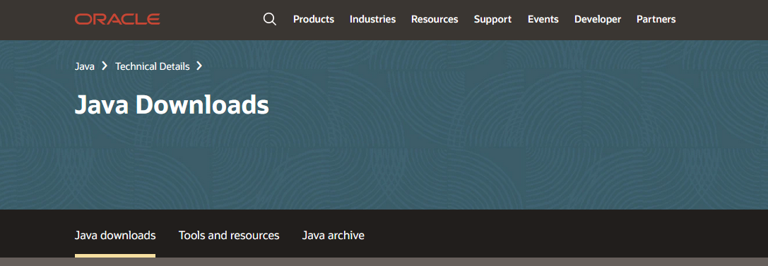
Installing Java JDK
First we need to install Java
https://www.oracle.com/java/technologies/downloads/

Slide 4
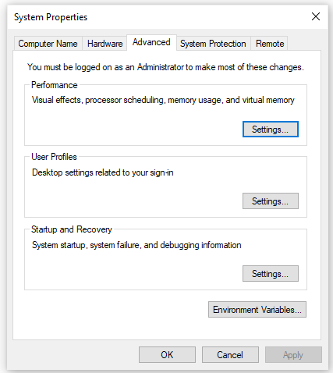
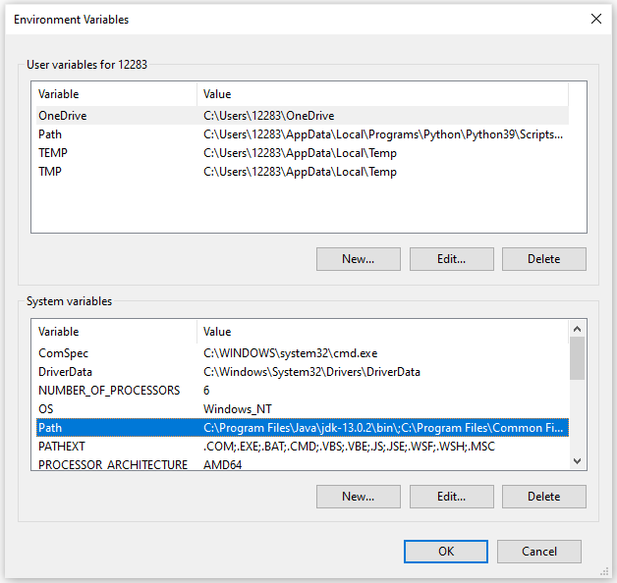
Add the JDK to your System Path Variable

Slide 5
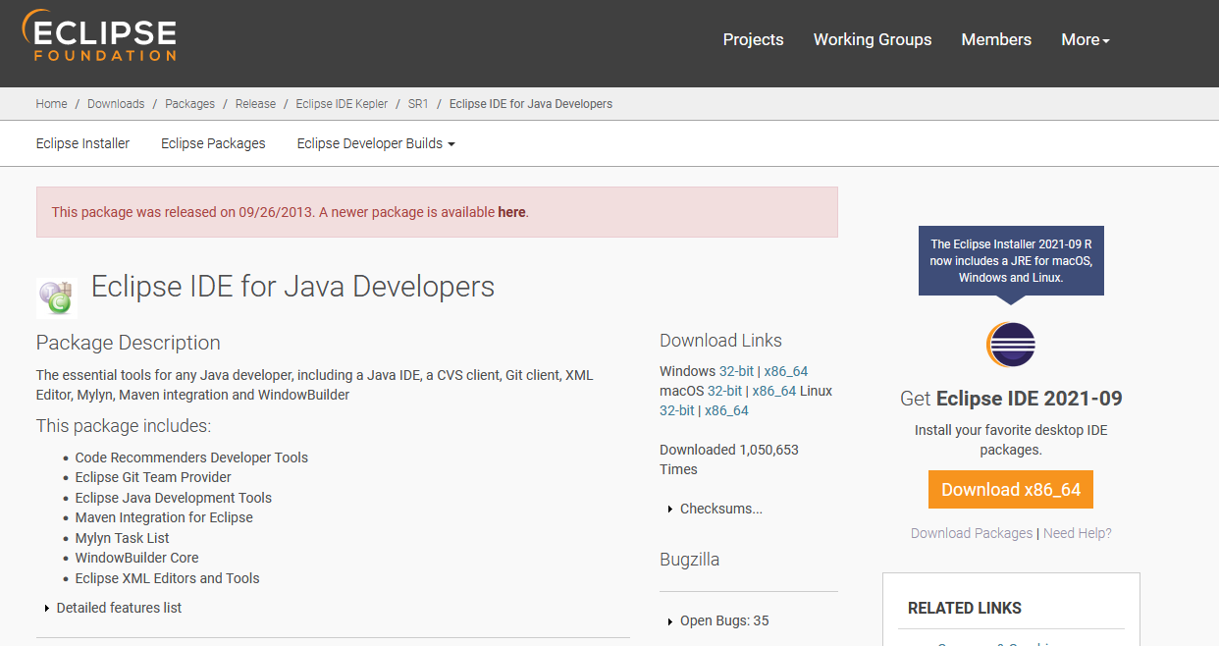
Installing Eclipse
Let’s install an Integrated Development Environment (IDE)
https://www.eclipse.org/downloads/packages/release/kepler/sr1/eclipse-ide-java-developers

Slide 6
A Java “Hello World” application
/******
Header block
******/
public class HelloWorld
{
public static void main(String [] args)
{
System.out.println("Hello World");
}
}

Slide 7
Compiling Options:
Command Line:
Most versatile
Most control
Least overhead
No bells & whistles
Highest learning curve
Cloud Compiling:
Most portability
Some bells & whistles
Great for testing small code segments
Least stable
Integrated Development Environments (IDE):
Provides built in debugging and organization utilities
Allows for plug-ins and auto-generators
Provides hints, suggestions, and real-time checking (not necessarily a good thing when you are first learning)

Slide 8
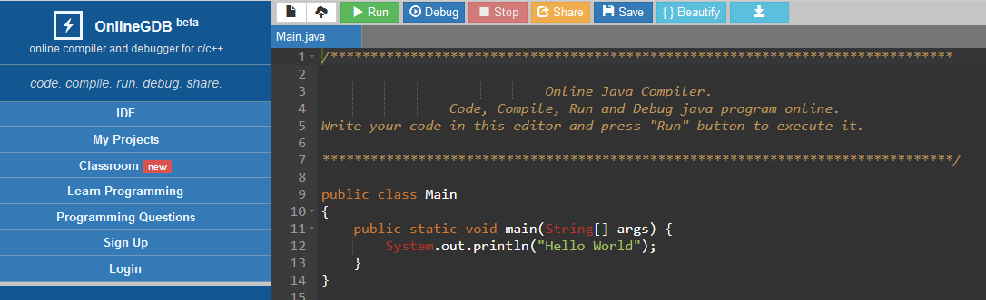
Cloud Compilers https://www.onlinegdb.com/online_java_compiler

Slide 9
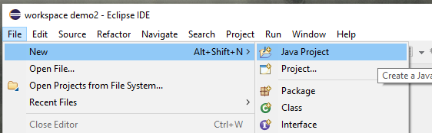
Setting up a project and coding in Eclipse
Select a workspace
Create a new project
Create a new Java file
Run and test
Explore on your own

Slide 10
What can you do to prepare for 5004?
Become familiar with the Java “Hello World” program
Get familiar with compiling from the command line
Get comfortable with an IDE interface and cloud compiler
Get a headstart on Java syntax

